Slide 1

Today’s objective
DATA ANALYTICS | IRONHACK

Slide 2

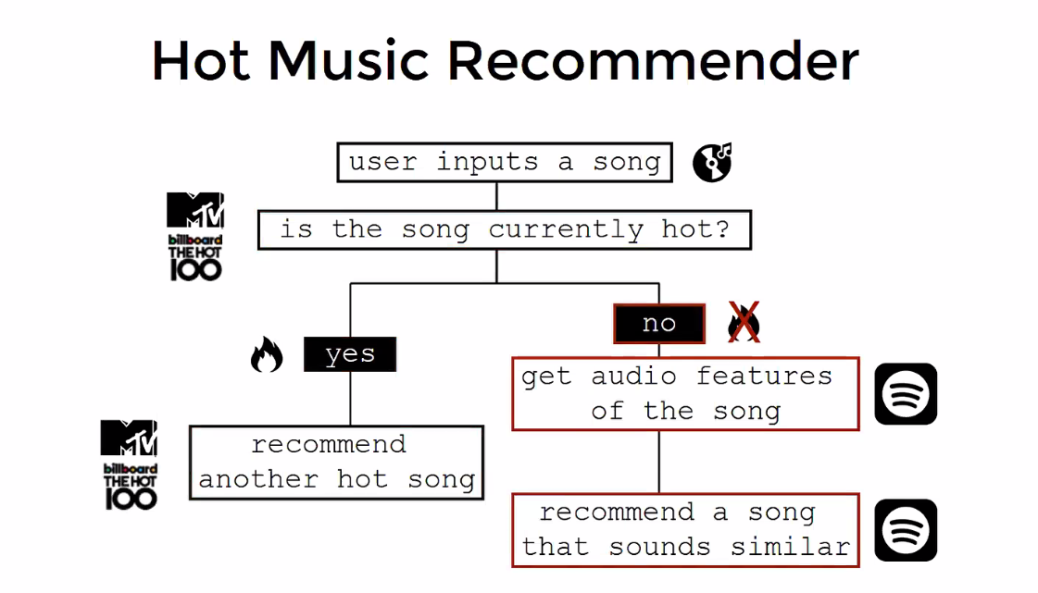
IRONHACK BOOTCAMP
Desired music recommender workflow

Slide 3
IRONHACK BOOTCAMP
Today’s objective:
Create a second function to retrieve the audio features of a given song.
Create a third function to update the internal database with the song features using the previous function and to add this information to the dataframe
Song’s url/ uri
Song’s audio_features
Recommendation: create a function to extend the internal database with songs of your choice/playlist,.... The more songs you have in the database, the better. (you will see tomorrow why).

Slide 4


